Slide 1
Bored games
Yang Chen · Adrian Coffey · Cristiano Gaudino
Paul Gunnarsson · William Orr · Michael Smith

Slide 2
Contents
Website
Backend
Topdown

Slide 3
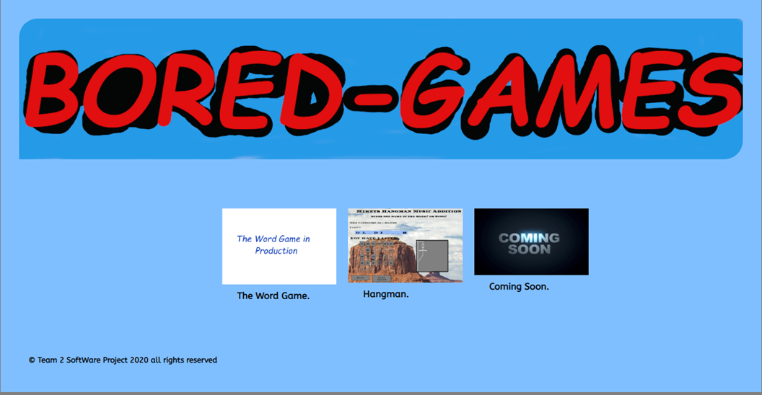
Website

Slide 4
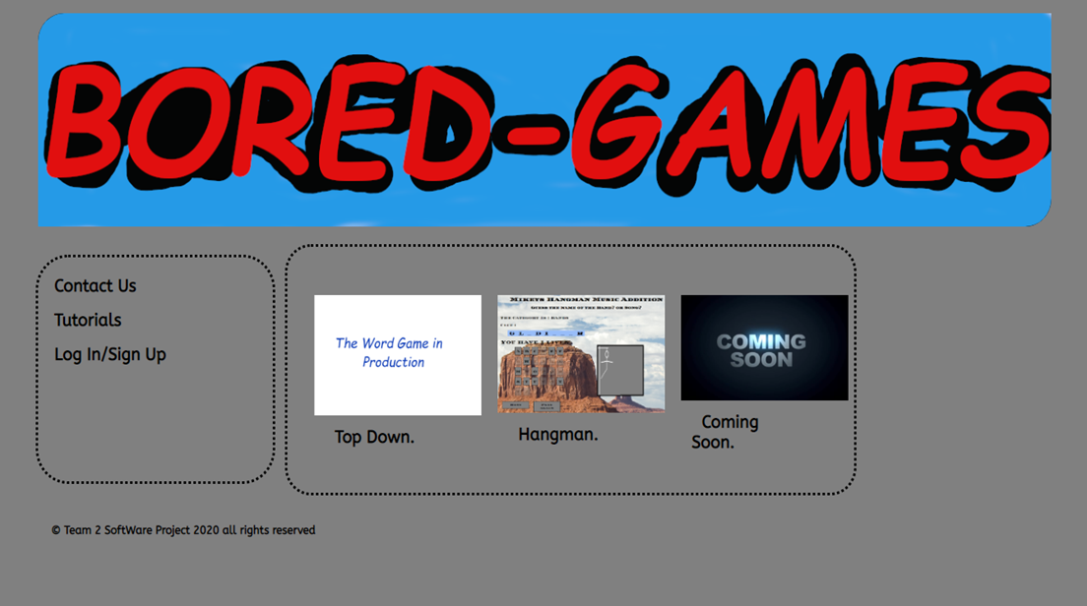

Slide 5

Backend

Slide 6

What did we need?

Slide 7
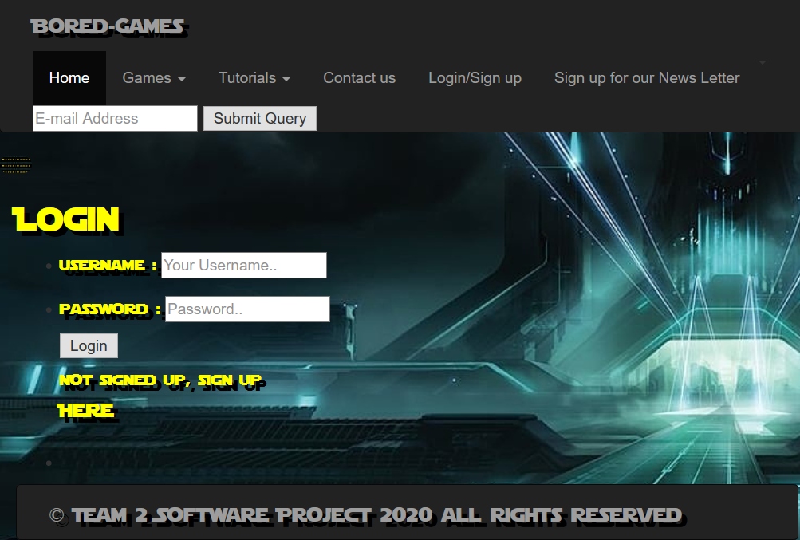
What did we need?
A login/register page

Slide 8
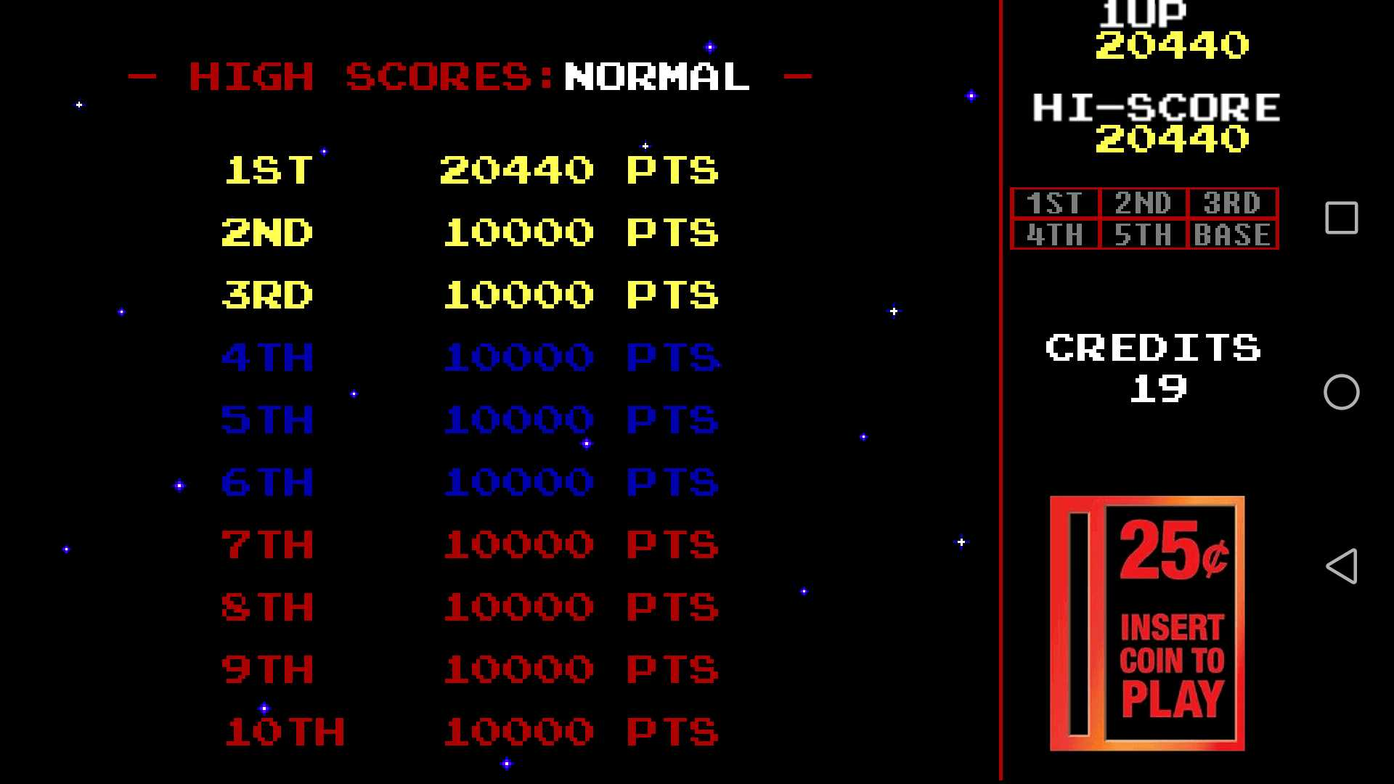
What did we need?
A login/register page
A scoreboard

Slide 9
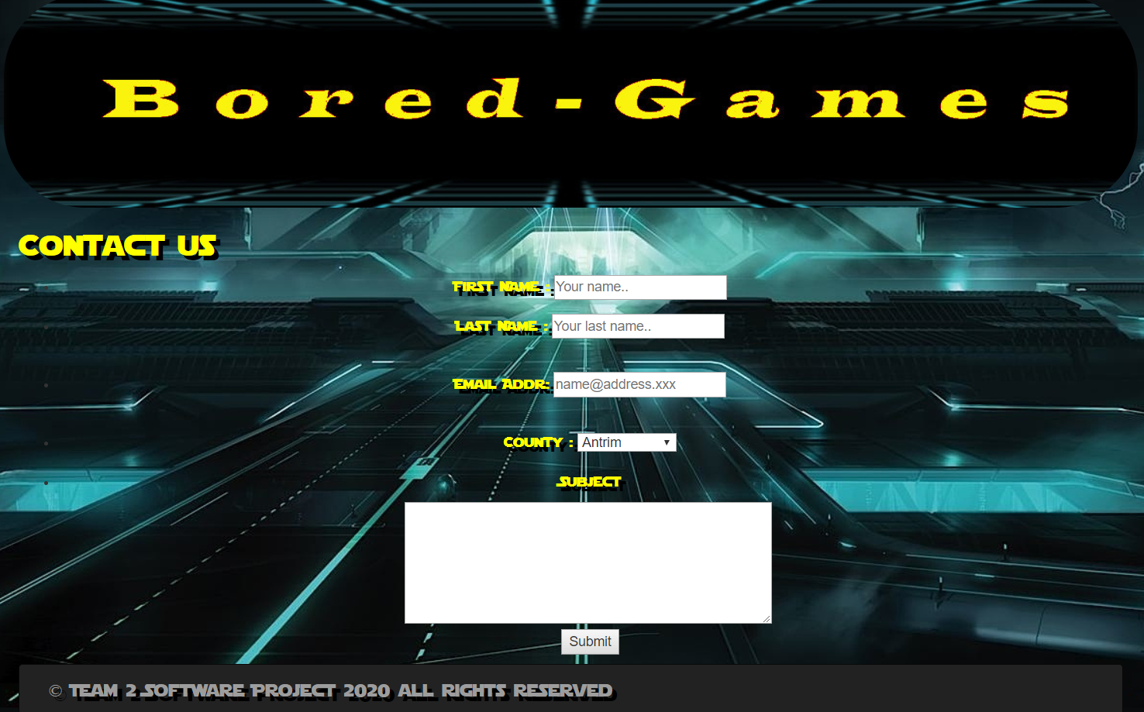
What did we need?
A login/register page
A scoreboard
A Contact us page

Slide 10


What did we use?
MySQLi
PHP

Slide 11

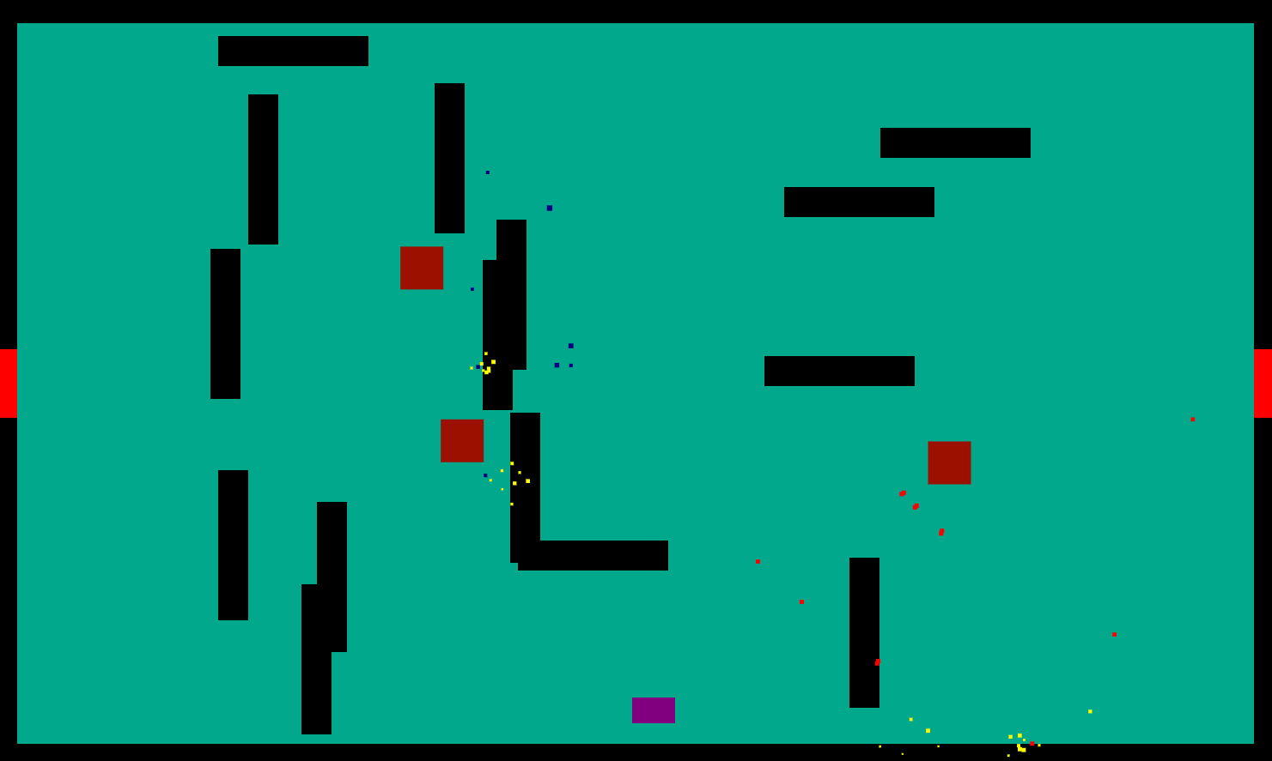
Topdown

Slide 12

An introduction to henry

Slide 14
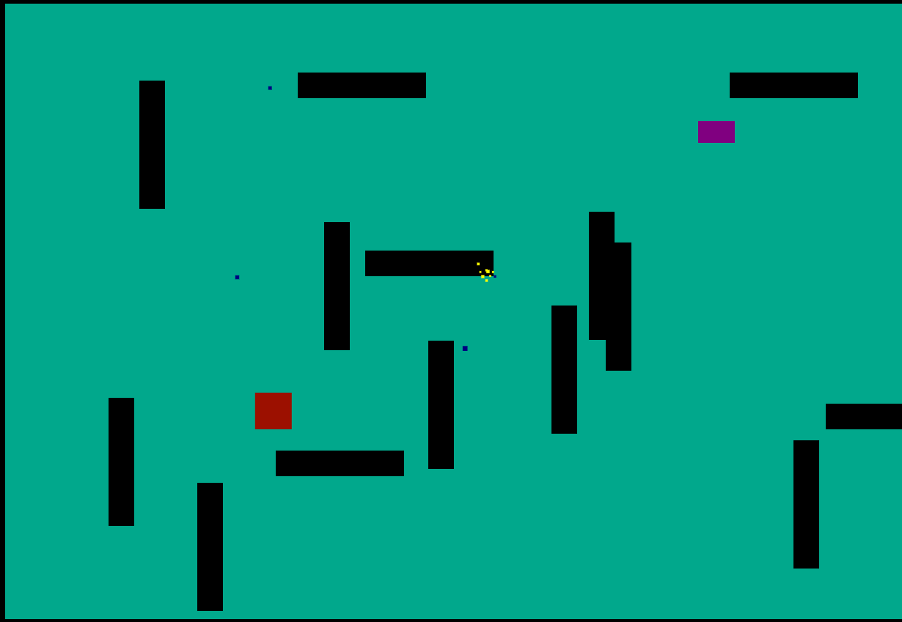
Henry's pathing

Slide 15





Slide 16
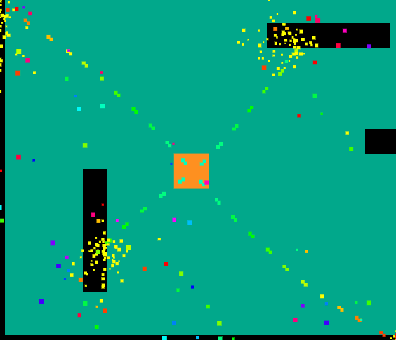
Boss battle

Slide 17
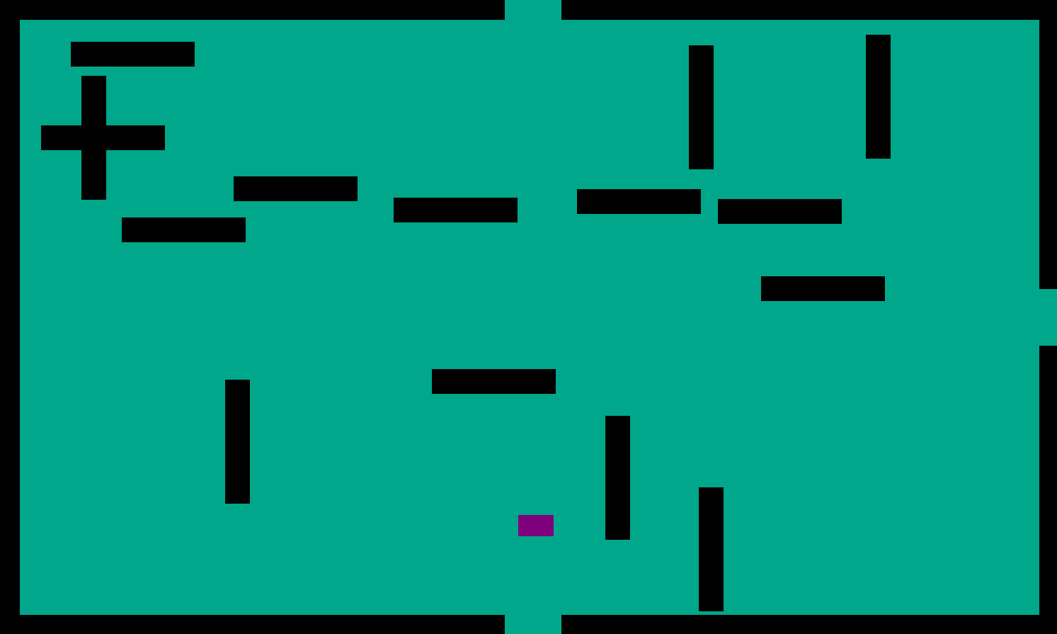
Room generation
Each time the game is reloaded, the map has changed
Rooms may branch out
The types of henry’s will start to vary more

Slide 18
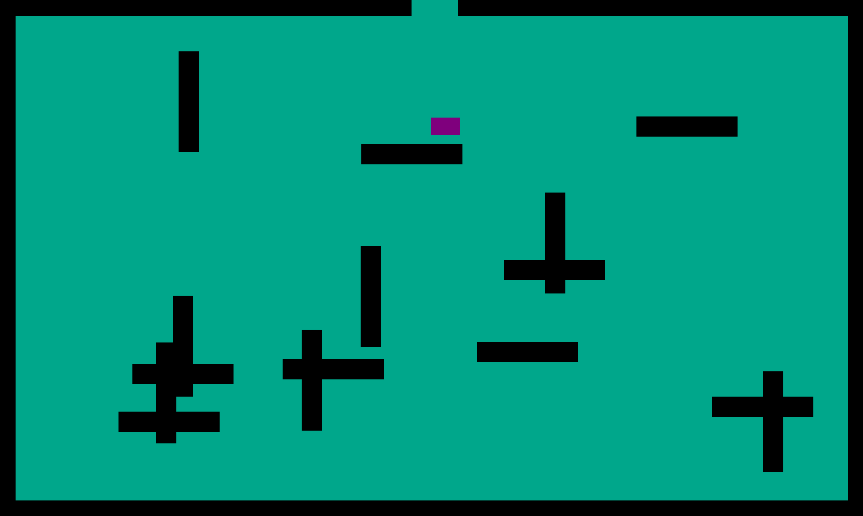
Each room also has its own random features

Slide 19
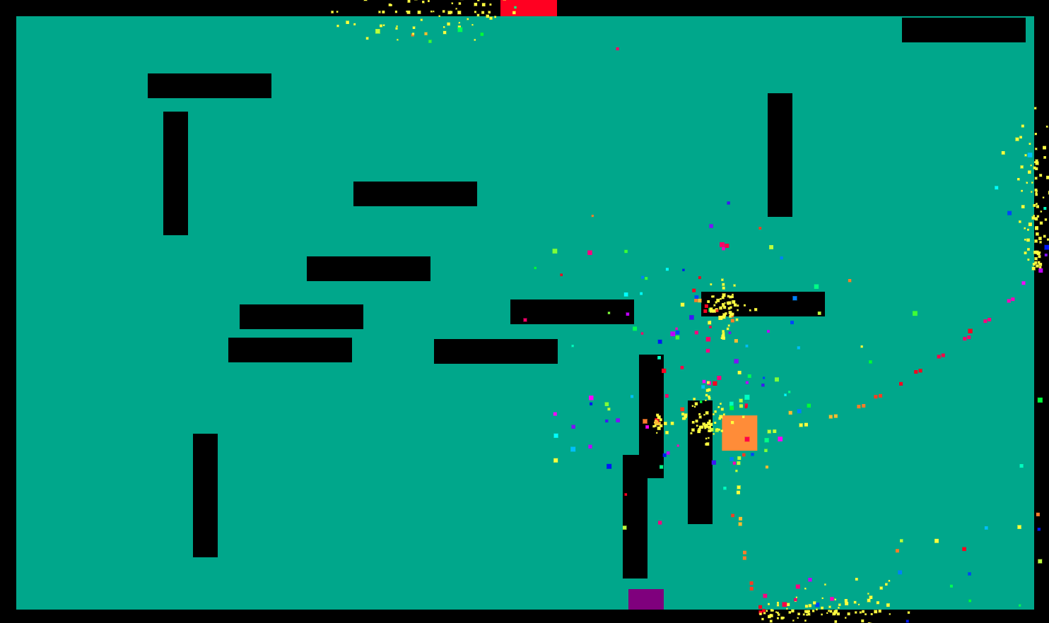
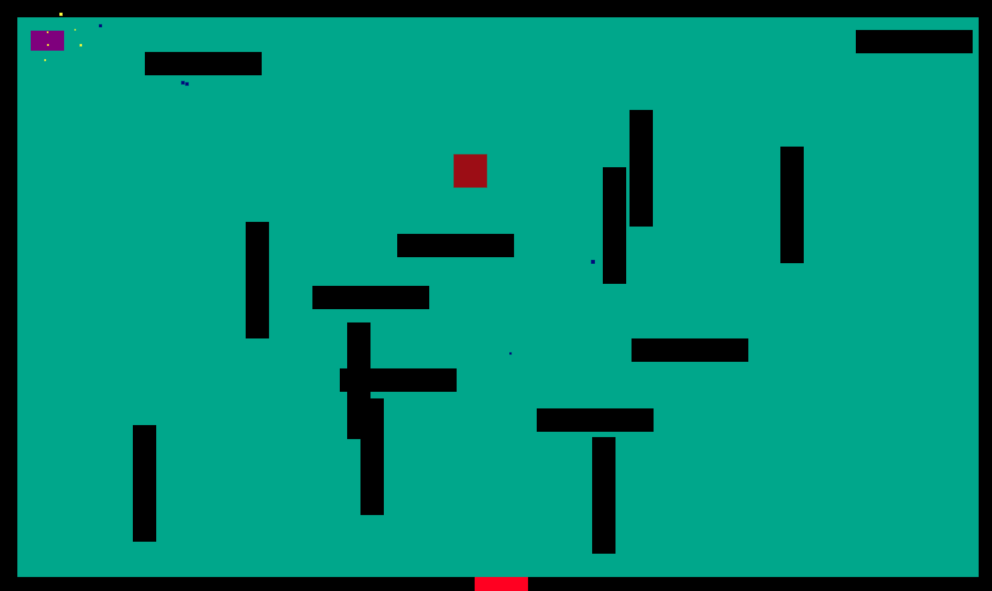
The player is locked in a room until all henrys are destroyed
Stephen will always spawn in the final room
The player wins by destroying all henrys in the map

Slide 20
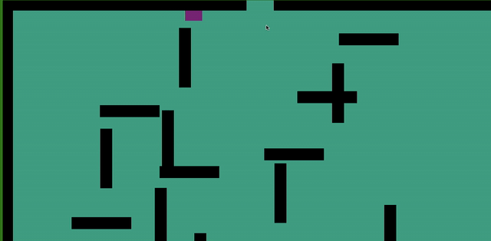
The movement of the player
We Use WASD to control the forward, backward left and right

Slide 21
Player shooting
Firstly, We set the spacebar to shoot and the direction of the bullet is forward.
But it is too difficult to win.
So we changed the shooting method to use the mouse to control the shooting direction, and click to achieve shooting

Slide 22
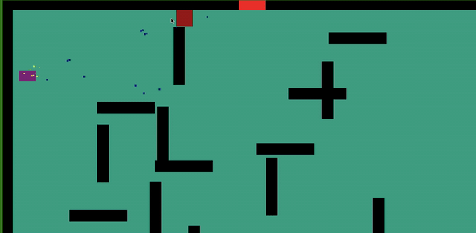
The health pack
when you are low on health, it will appear. You can use it to add your health value. It will only appear two times.

Slide 23
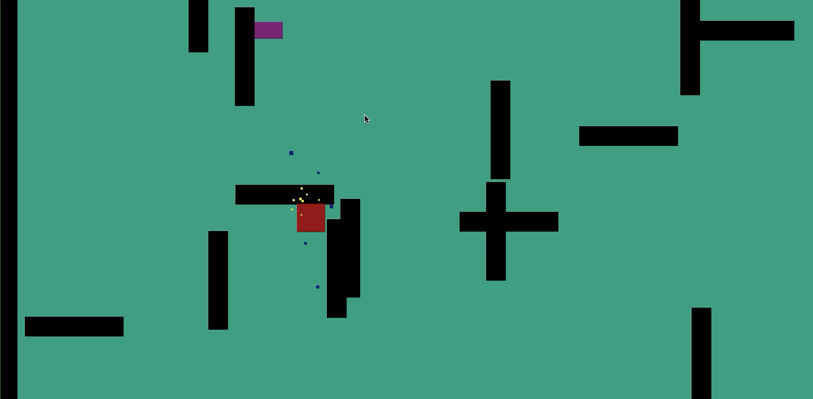
Winning the game
After you passed all the levels you will be congratulated

